Slide 1
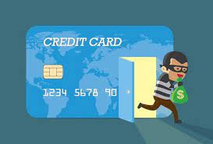
Credit Card Fraud Detection
BY :
ANSHU MANI

Slide 2
AGENDA
OBJECTIVE
BACKGROUND
KEY INSIGHTS
MODEL EVALUATION AND RECOMMEDATION
FINANCIAL IMPLICATION
APPENDIX :
Data attributes
Data Methodology
Models

Slide 3
OBJECTIVE
Building a fraud detection system using different machine learning techniques for Finnex, a leading financial service provider in US.
To recommend optimal ways and preferable machine learning model Finnex can employ to mitigate fraud risks and prevent heavy financial losses.
Demonstrating the potential benefits of the final model through a cost-benefit analysis in order to analyse the business impact of fraudulent transactions.

Slide 4
BACKGROUND
Finex is a leading financial service provider based out of Florida, US. It offers a wide range of products and business services to customers through different channels, ranging from in-person banking and ATMs to online banking. Over the last few years, Finex has observed that a significantly large number of unauthorized transactions are being made, due to which the bank has been facing a huge revenue and profitability crisis.
Many customers have been complaining about unauthorized transactions being made through their credit/debit cards. It has been reported that fraudsters use stolen/lost cards to access the personal and sensitive data of many cardholders. Other ways in which Fraudulent transactions take place is skimming, alteration of genuine credit cards, counterfeit cards.
In most cases, customers get to know of such unauthorized transactions happening through their cards quite late as they are unaware of such ongoing credit card frauds or they do not monitor their bank account activities closely. This has led to late complaint registration with Finex and by the time the case is flagged fraudulent, the bank incurs heavy losses and ends up paying the lost amount to the cardholders.

Slide 5
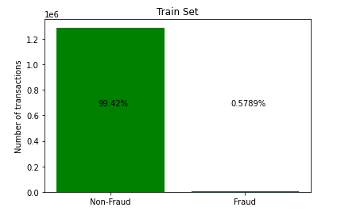
DATA IMBALANCE
The dataset is highly imbalanced with positive class (frauds)accounting for 0.57% of the total transactions. This is a case of Minority class problem.
The ‘is_fraud’ column represents the target variable. It takes the value 1 in case of a fraudulent transaction and 0 otherwise.
The imbalance in the target variable is mitigated using Sampling techniques such as SMOTE and ADASYN.

Slide 6
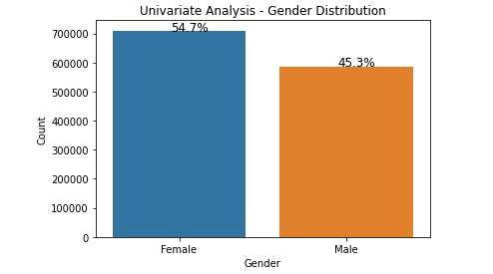
GENDER DISTRIBUTION
Women contribute more to the amount of transaction frequencies as compared to men. Hence they can be more prone to frauds .
Percentage of female credit card holders is more as compared to male. Approx. 55% of the transactions are done where users are female.
Women should be educated and trained about the various ways in which credit card frauds take place.

Slide 7
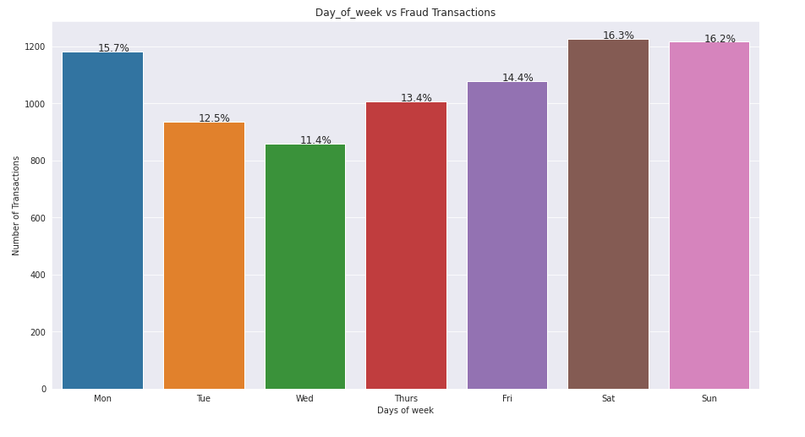
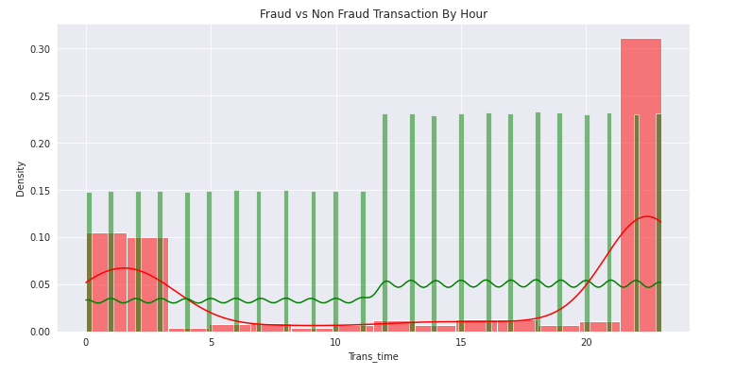
FRAUD DISTRIBUTION
More fraudulent transactions take place on weekends than on weekdays.
A fraudulent transaction seem to have less anomaly as compared to non-fraudulent transaction as most of the users go shopping and travelling on weekends only.
Most fraudulent transactions happen at late nights between 22:00Hrs and 3:00 Hrs.

Slide 8
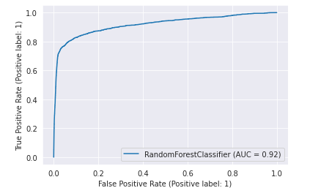
MODEL RECOMMEDATION
Out of all the models we evaluated, we recommend adoption of Random Forest ADASYN as the most preferable model with a recall score of 0.76 and AUC score 0.92.
What we were looking for is the detection of maximum fraudulent transaction as the primary goal and a low false positive rate to dissipate customer dissatisfaction.
Unless a perfect classifier can be designed, maximizing the recall comes at a cost in terms of false positives. The AUC under ROC Curve comes as the most widely used metric to circumvent this conflicting goal.

Slide 9
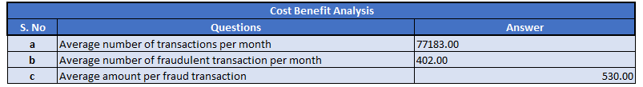
FINANCIAL IMPLICATIONS
After the model has been built we perform a cost-benefit analysis to demonstrate its potential benefits. For this we compared the cost incurred before and after the model is deployed.
After the model is deployed, the bank can develop a 2nd layer of authentication for each of the transaction that the model predicts as fraudulent. This would cost around $1.5 per fraudulent transaction.
The final cost incurred will only be due to left out fraudulent transactions that the model fails to detect and the installation cost of 2nd layer of authentication service .

Slide 10
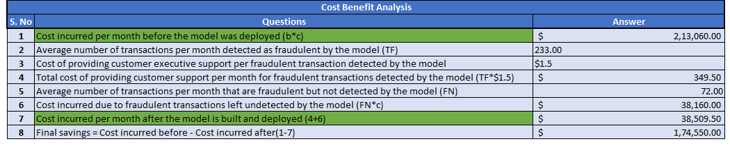
FINANCIAL IMPLICATIONS
Cost incurred per month before the model was deployed = Average amount per fraudulent transaction * Average number of fraudulent transactions per month
cost incurred per month after the model is built and deployed = 1.5*TF + Average amount per fraudulent transaction * FN.
Final savings = Cost incurred before - Cost incurred after.

Slide 11
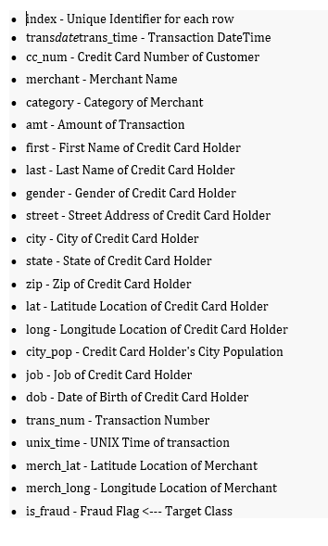
APPENDIX - Data Attributes
Snapshot of the dataset.
Is_fraud is the target column.

Slide 12
APPENDIX- Data Methodology
We conducted through Exploratory Analysis of the Credit Card dataset. There were no missing values in the dataset.
Skewness was there in some of the features which was handled using log transformations.
Some new features were derived using the original columns and irrelevant columns were dropped.
Week, month,trans_time were created using transdatetrans_time.
Distance between customer and merchant location was calculated using haversine distance .

Slide 13
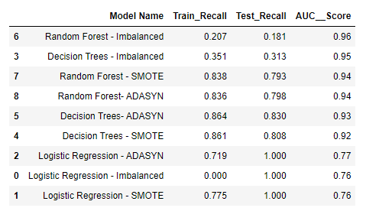
APPENDIX - MODELS
We performed the required cross validation and tried different models starting from a linear baseline model and later building upon it ensembles.
A reasonable variety of different models were tested and evaluated on both imbalanced and balanced classes.
Stratified Train/test split was done so that each fold is a representative of all the strata of data.

Slide 14
Link for video presentation : https://drive.google.com/file/d/1-05B-yJk42teMP9AyZfQTLnZEPrZ8ijF/view?usp=sharing

